Slide 1
Consumer Loan Securitization Review
OMFIT 2019-2
Mathew Simons
November 2023

Slide 2
What is Securitization?
Securitization is the process of taking an illiquid asset or group of assets and, through financial engineering, transforming it (or them) into an investable security.
Source: Investopedia
Class A
Loan 1
Special
Purpose
Vehicle
(SPV)
Class B
Loan 2
Loan 3
Class C
. . .
Class D
Loan n
Class E
November 14, 2023

Slide 3
Securitization and Structured Finance
Structured finance is a heavily involved financial instrument presented to large financial institutions or companies with complicated financing needs who are unsatisfied with conventional financial products. Since the mid-1980s, structured finance has become popular in the finance industry. Collateralized debt obligations (CDOs), synthetic financial instruments, collateralized bond obligations (CBOs), and syndicated loans are examples of structured finance instruments
Source: Investopedia
Securitization is the core of structured finance. It is the method by which those in structured finance create asset pools and ultimately form complex financial instruments that are useful to corporations and investors with special needs.
Source: corporatefinanceinstitute.com

Slide 4
Real World Examples
Past 12 months
Auto loans/lease/floorplan
GM ~ $15.5 billion
Ford ~ $12 billion
Toyota ~ $10 billion
Capital One ~ $2 billion
RMBS
JPMorgan ~ $5.5 billion
Fannie Mae/Freddie Mac ~ $8 billion
Credit Card
American Express ~ $3.5 billion

Slide 5
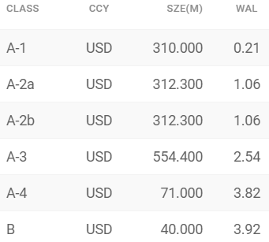
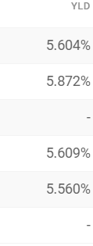
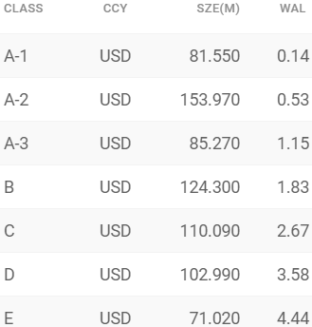
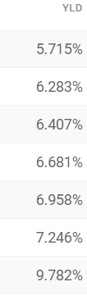
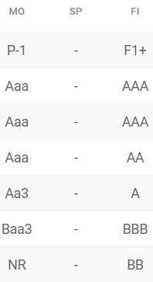
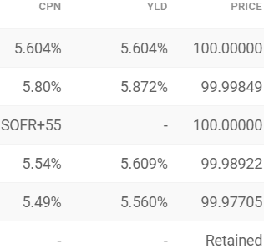
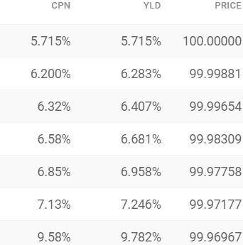
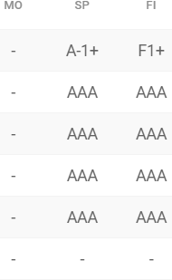
Risk vs Return
Toyota (prime auto loans)
Exeter (non-prime auto loans)
Source: Finsight

Slide 6
OneMain
Online lending platform
Focuses on non-prime borrowers that would not be able to get a loan from a traditional bank
Offers various products (auto loans, personal loans, credit cards)
Average APR on loans originated in 2022 -> 26%
OneMain has securitized ~ $3.5 billion in last one year
~ $3 billion in consumer

Slide 7
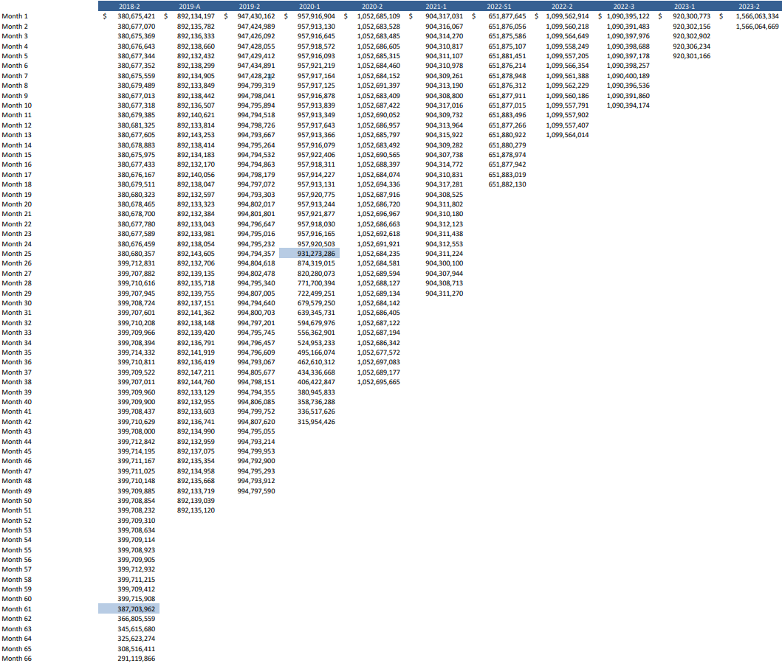
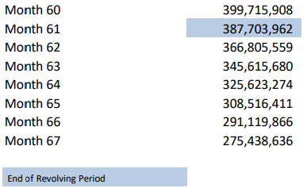
Balance History
Currently 11 outstanding consumer loan ABS
Source: OneMain

Slide 8
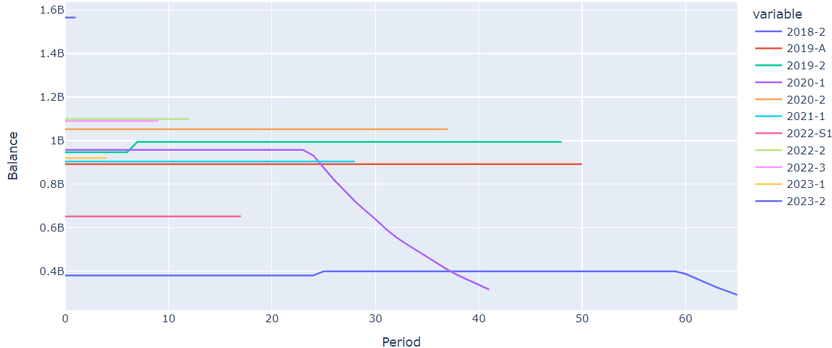
Balance History
Notes:
Ups and downs that are not uniform

Slide 9
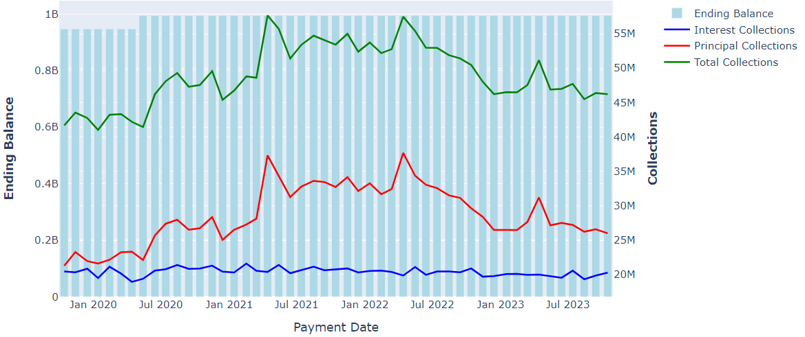
OMFIT 2019-2 Balance and Collections

Slide 10
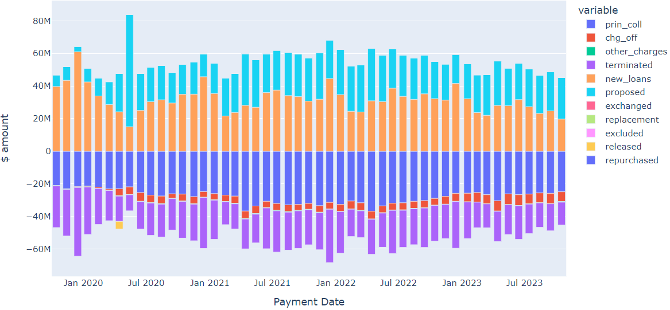
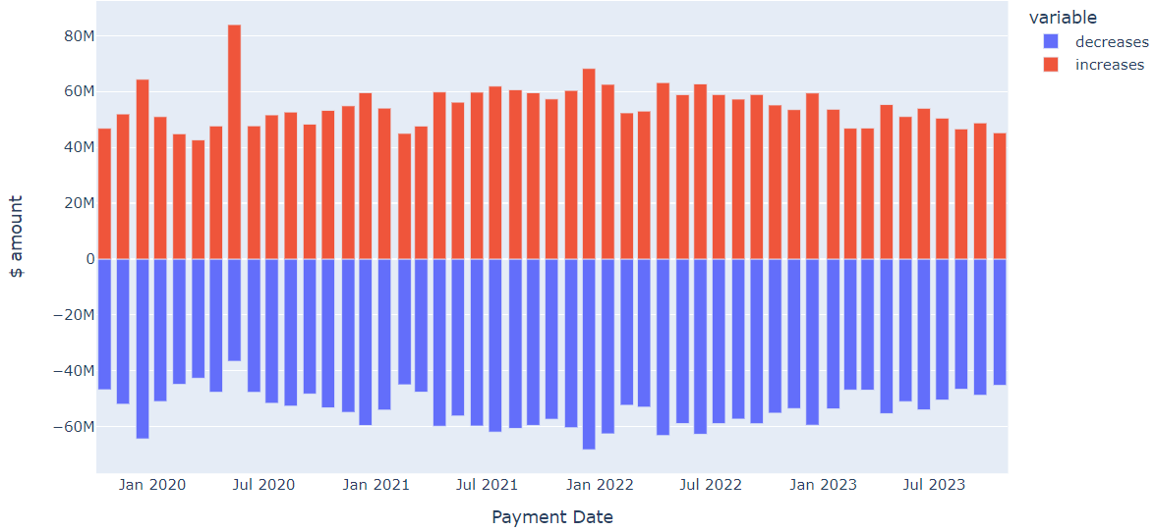
Components of Balance

Slide 11
Credit Enhancement and it’s many forms
Subordination
Percent of capital structure below each bond
Overcollateralization
Amount pool balance exceeds class balance
Can be calculated for each tranche and total deal
Reserve Account
A cash account used to cover shortfalls
Excess spread
Excess of pool collections over what is owed to expenses and classes

Slide 12
Interest
Principal
Protection
from losses
Class A
40%
What if losses are … ?
Class B
30%
30%
5%
10%
100%
Class C
20%
10%
Class D
Losses

Slide 13
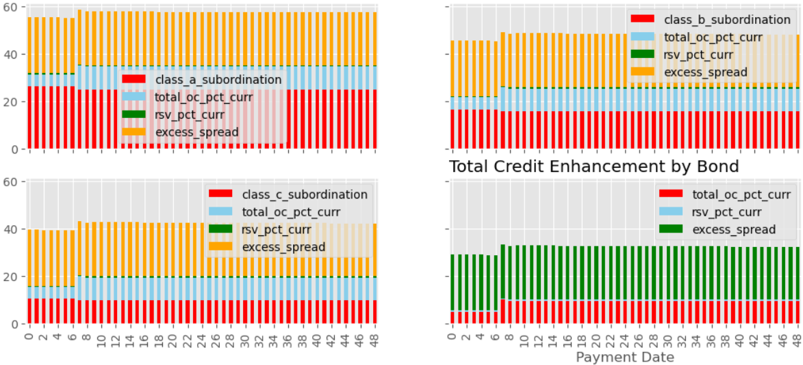
Credit Enhancement and it’s many forms

Slide 14
Credit Enhancement and it’s many forms

Slide 15
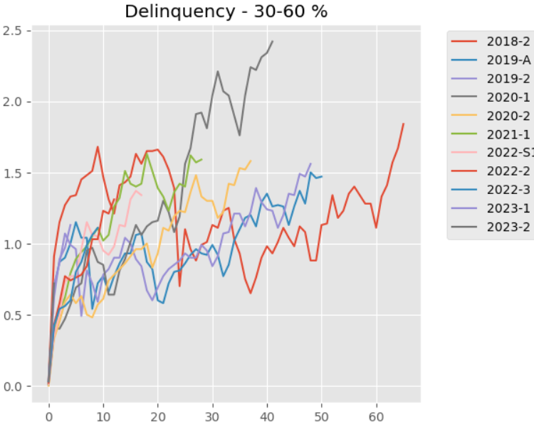
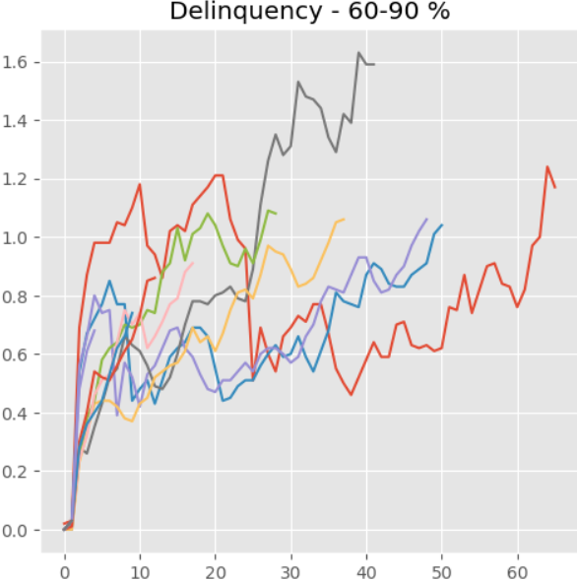
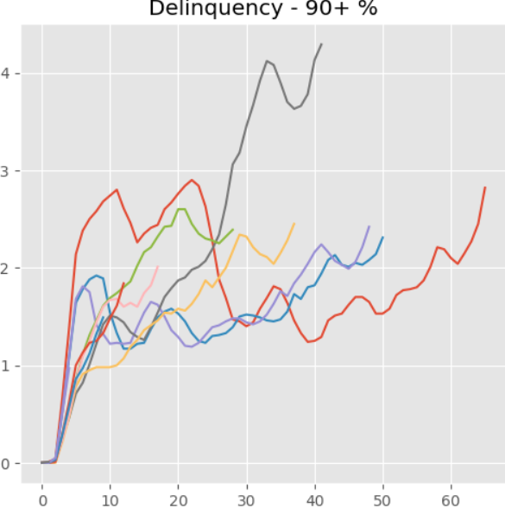
Delinquency
Source: OneMain monthly performance report
Notes:
Add y and x axis titles

Slide 16
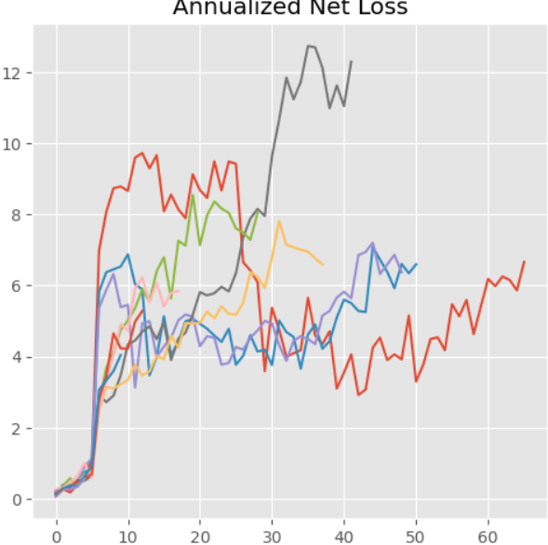
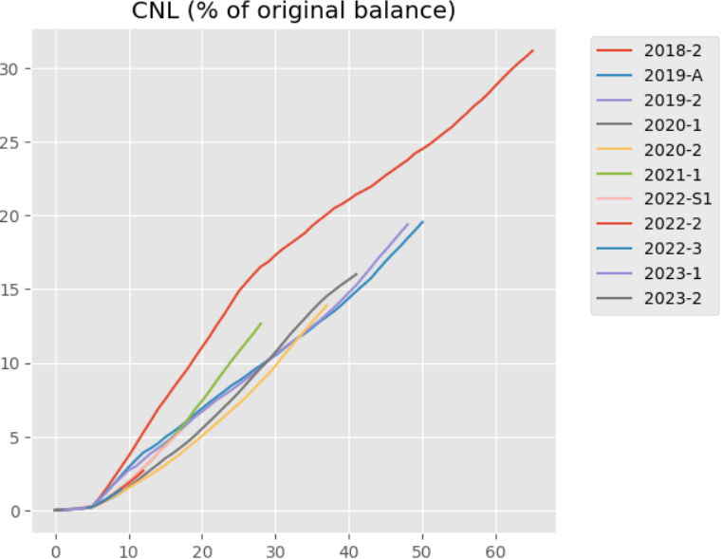
Losses

Slide 17
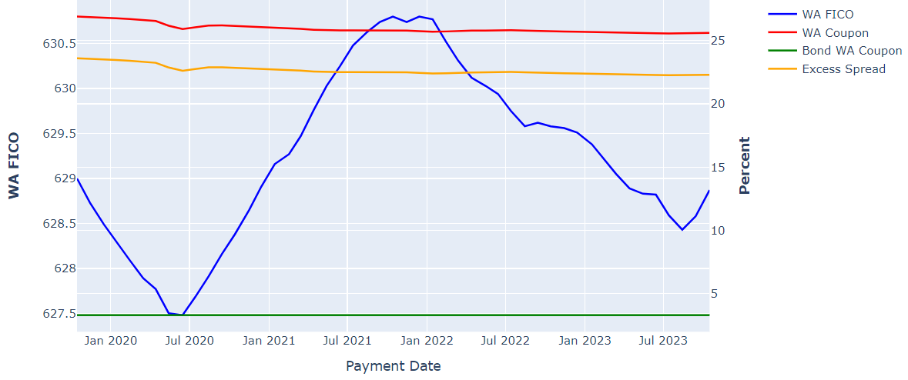
Weighted Average Coupon and FICO
Notes:
Fico not fixed across time
Possible reasons for shift

Slide 18
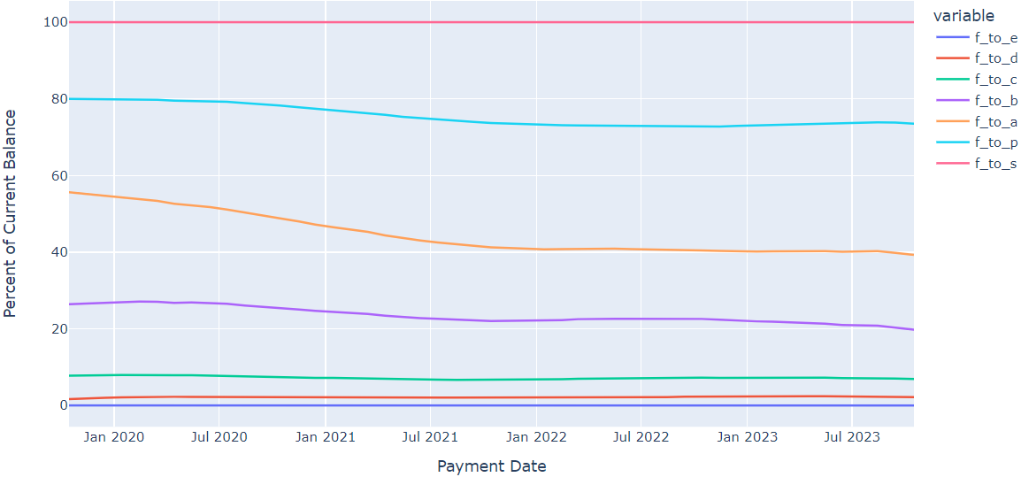
Reinvestment Criteria

Slide 19
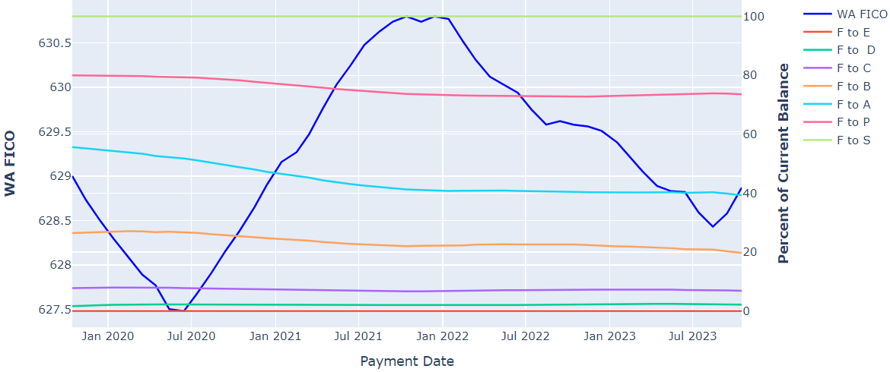
Shifting Characteristics

Slide 20
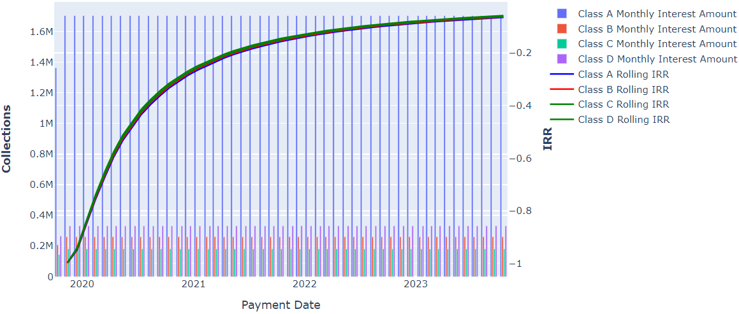

Returns to date
$$Interest Payment$$
$$=$$
$$rate$$
$$∗$$
$$beginning balance$$
$$∗$$
$$\frac{days in accrual period}{360}$$

Slide 21
Future Considerations
Make the code more dynamic
Next step would to be have it work for any OneMain deal
Because there isn’t reporting standardization across issuers and trustees, it would be very difficult to create a universal script. However, much of this data is available from data sources like Bloomberg. With access to already clean data, it would be much easier to compare across issuers and asset classes.
With loan level data, more insight can be gleaned into how certain loan characteristics correlate with performance (i.e. do lower FICOs really lead to higher defaults)
There are additional performance metrics that can be calculated with loan level data (i.e. roll rate, which is the percent of borrowers that move from one delinquency bucket to the next)

Slide 22
Interest
Principal
Protection
from losses
Class A
40%
What if losses are … ?
Class B
30%
30%
5%
10%
100%
Class C
20%
10%
Class D
Losses

Slide 23

OMFIT 2019-2

Slide 24

Agenda
Securitization Overview
What is securitization and structured finance?
Review OneMain ABS portfolio
We’ll take a look at how OneMain’s consumer loan portfolios have been performing as a whole
OMFIT 2019-2
Take a closer look at the performance of a specific OneMain ABS
November 14, 2023

Slide 25
Securitization Overview

Slide 26
OneMain Consumer ABS Overview

